Slide 1
scaling-up Non sewer sanitation
Roshan Shrestha, PhD
Senior Program Officer/Technical Lead South Asia

Slide 2
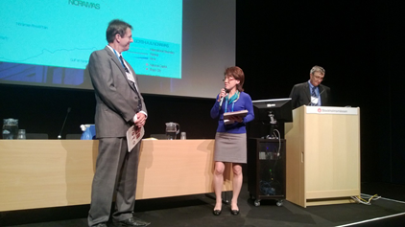

Looking back - www 2013
Limited investment in Non-sewered sanitation (NSS) and FSM
None of the South Asian countries had any policy and institutional frame to address NSS/FSM
Limited understanding of NSS and FSM
MDG era focus was only on access to basic sanitation

Slide 3
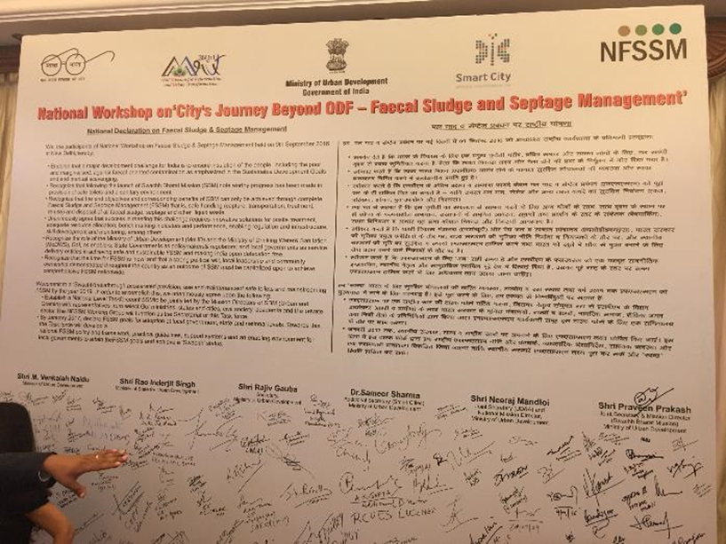
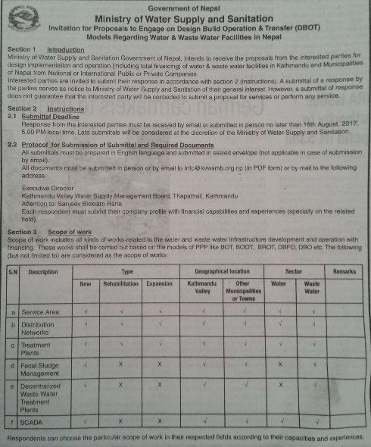
Today - www 2017
Sanitation Trust fund
Asian Development’s investment in NSS
FSM is now global agenda due to the SDG
In case of South Asia, India, Bangladesh and Nepal has endorsed policies and institutional framework on FSM
Several Cities have initiated FSM projects and developed city level policies
Developments banks have increased investment in FSM
Successful FSM projects in several cities in the region.

Slide 4
Debate on sewerage and non-sewerage still on- going
Flush toilet
Sewer network pumping stations
Treatment plant
Sewerage
Vacuum truck
Non-sewerage
Pit or
septic tank
Treatment plant
Primary emptying
Transfer
Notes:
Sewerage
Sewerage system is still a priority, people believe that sewerage is the only solution and NSS is only a temporary
Most of the urban infrastructure projects sewerage and wastewater treatment plants are the major investment
NSS
No or little investment on FSTP only
Large projects do not consider FSM needs to be included
Consulting companies do know how to address FSM in large projects
NSS is considered as HHs business

Slide 5
Budget for Wastewater in 2016-17- India
Description | Total Budget USD/Billion | Budget USD/capita
AMRUT | 0.63 | 0.15
State and City | 0.20 | 0.15
Smart City | 0.50 | 0.10
National River Conservation | 0.06 | 0.01
SPM Rurban Mission | 0.04 | 0.01
Namami Gange Mission | 0.35 | 0.14
External Assistance | 3.38 | 0.13
Total | 5.16 | 0.69
Current Per-capita budget for wastewater is less than 1 $
Source: BORDA, 2017

Slide 6
Cost of solutions - Capex & OPEX
Options | Capex / capita (USD) | Opex / capita (USD)
Sewerage system | 48 – 650 | 5 – 56
FSM | 8 – 30 | 2 – 4
Average CAPEX of UGD per capita = $250
$ 250
Average CAPEX of UDG per capita
$ 0.69
Budget per year/Per Capita
Source: BORDA, 2017

Slide 7
Comparing the Scenarios
100%
99%
Scenario -1
98% on sewerage
2% for FSM
57%
Scenario-2
80% for sewerage
20% for FSM CC
% COVERAGE
50%
51%
30%
6%
0%
42%
At the cost of not giving UGD to 3%, FSM can be provided to 51% of the population
45%
30%
2026
2017

Slide 8
Multiple SANITATION solutions
SDGs
Water closet
Sewer network pumping stations
Treatment plant
Sewerage
Vacuum truck
Fecal Sludge
Management
for on-site
systems
Pit or
septic tank
Treatment plant
Primary emptying
Transfer

Slide 9
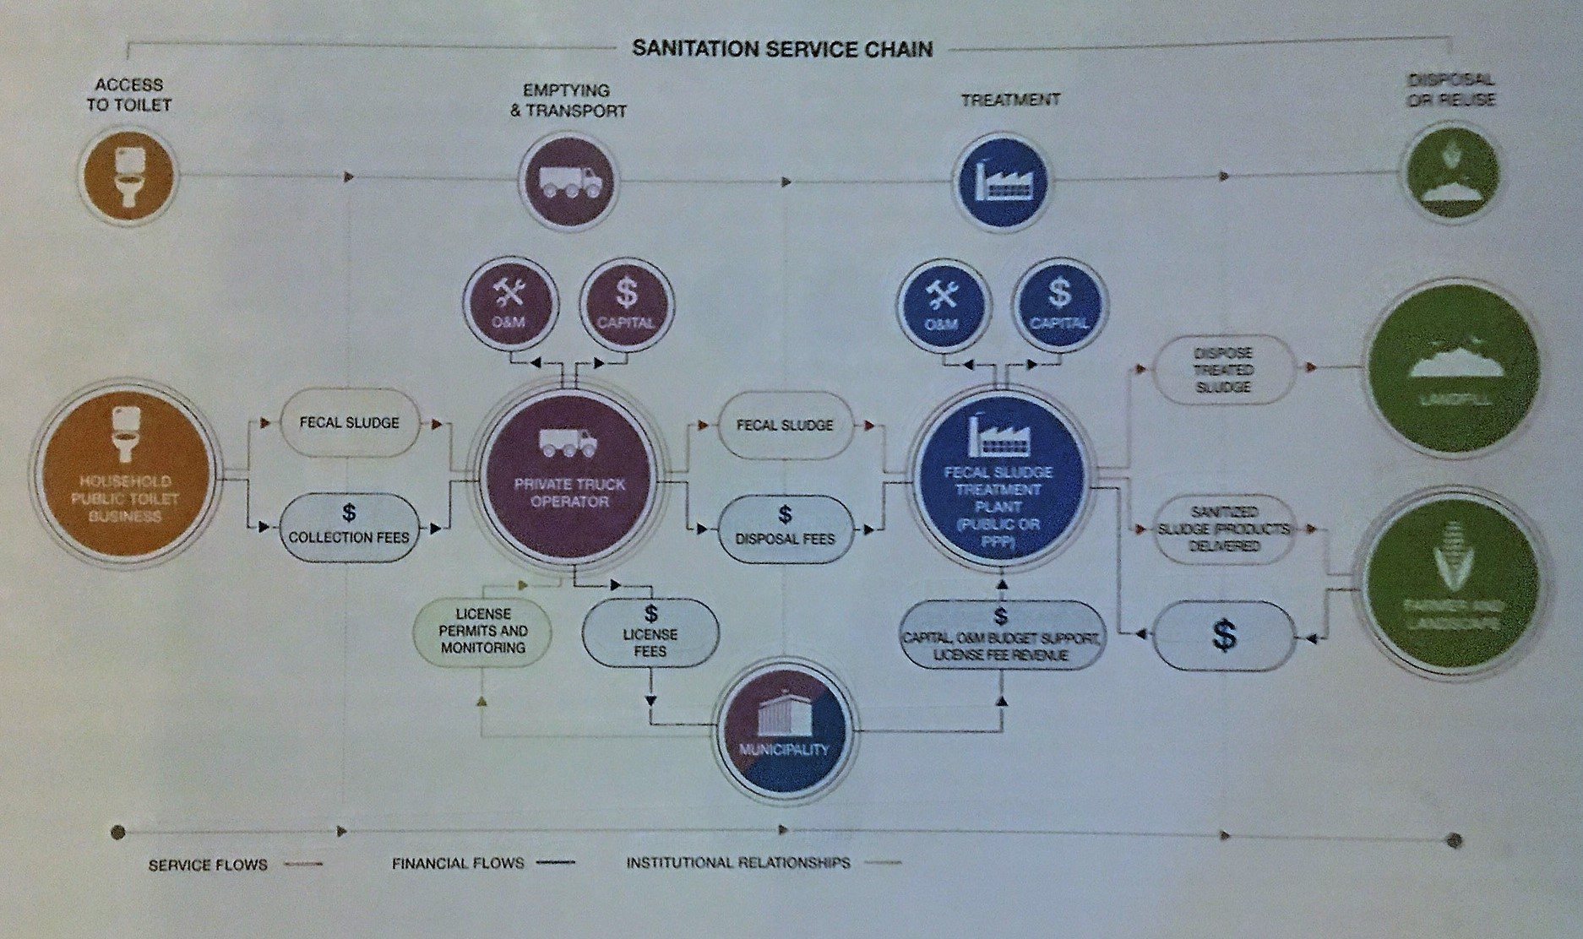
FSM is not only an infrastructure
Source: CGIAR/IWMI, 2016

Slide 10
Theory of change: We will focus investments to drive city-level change and replication to global scale
Accountable
Govt institutions and political will
Clear accountable Ministry, National/ state political will, and policies and regulation, incl recognition of sanitation as utility, are necessary conditions for success
Functioning and accountable institutions, National/ state sanitation policies and regulation;; robust measurement and enforcement; sustainable support
Creating demand for FSM and strong enabling environments at the national and municipal level will facilitate / accelerate the adoption of new OP, OI, and RT technologies as they become available.
Enabling Environment
FSM Policy and Enforcement
All human fecal waste is safely treated in the urban areas of Sub-Saharan Africa and South Asian Countries by transforming the way cities manage the sanitation value chain
Financing
To catalyze and sustain demand for effective FSM impact across the value chain, we will apply continuous innovation and then scale what works
Provide actors along the value chain with knowledge, resources, tools, and capacity to overcome barriers to sustainable sanitation, by supporting behavior change and best practice sharing
Innovate and Scale
Capacity Building
Business models
Cities today don’t need to wait for new technologies in order to improve sanitation; a utility model can be established to drive change
Given sufficient guidance, capacity, and resources to implement, cities can use existing technologies under a utility model to support economically and environmentally sustainable sanitation plans
Cities are the Unit of Change
Sanitation as Utility
City wide investments
“bend the curve”

Slide 11

THANK YOU!
Q & A
Notes:
Photo ID: coming via Stephen Walter
A young boy in Pune, India, 2014

